Slide 1

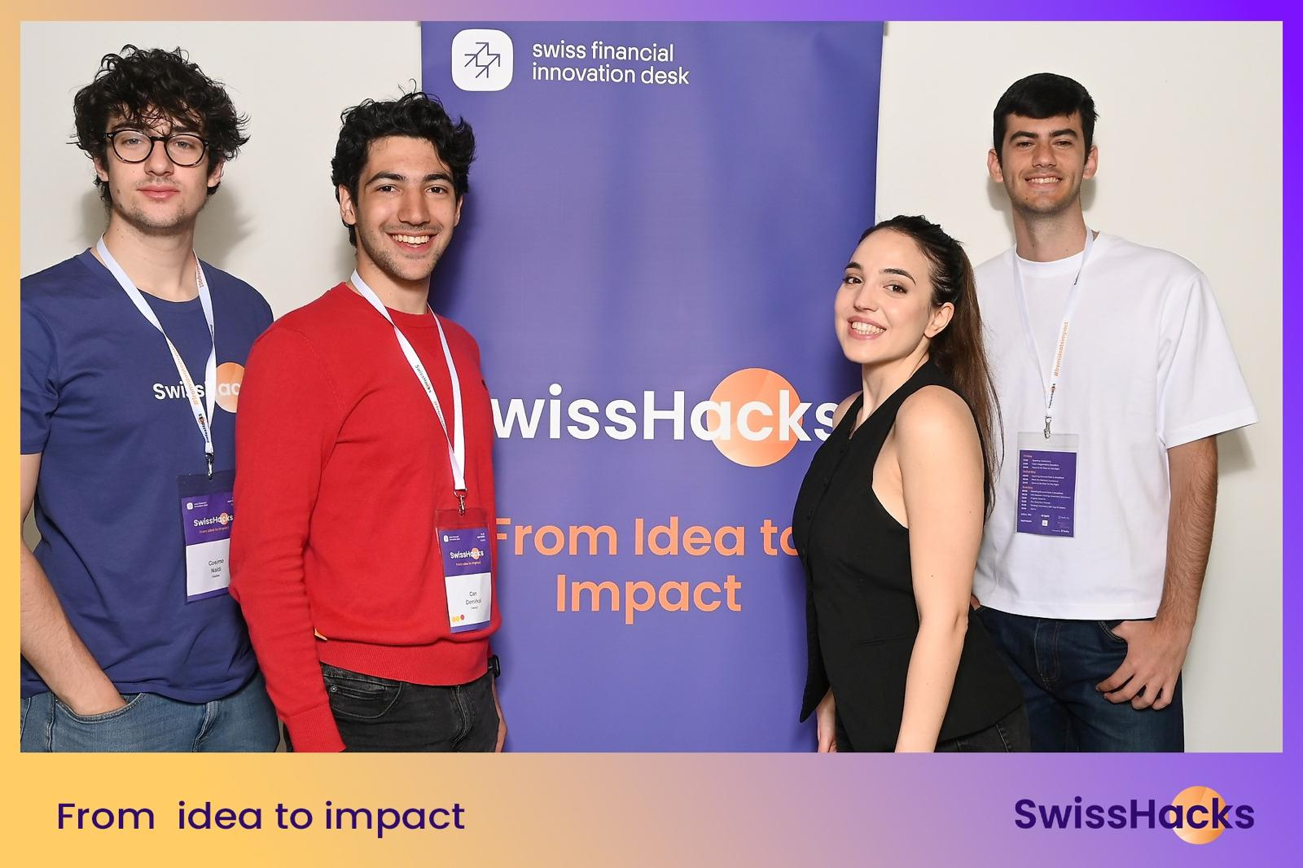
TechBabies

Slide 2
Our team, Techbabies, developed an add-on for your website to help investors easily access your startup data.

Slide 3
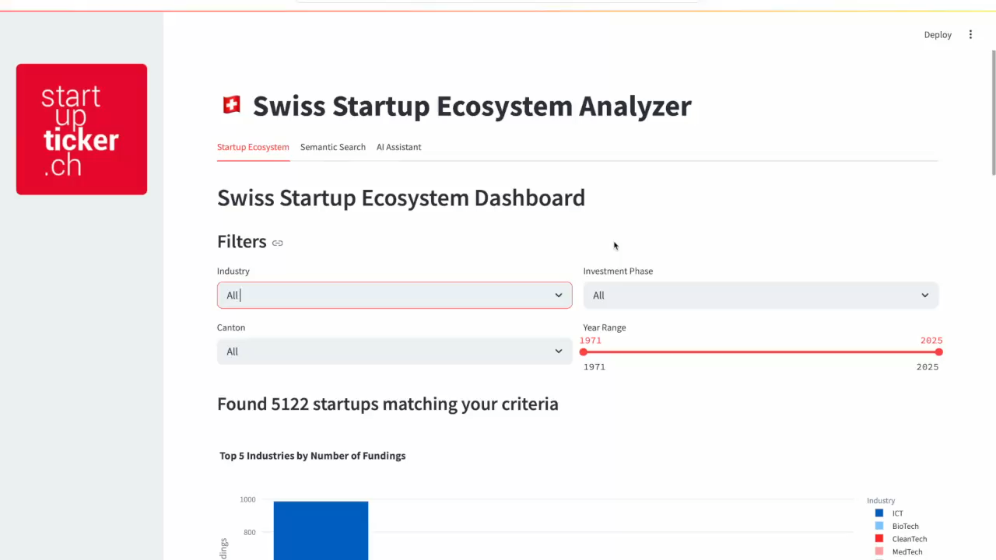

Slide 4





The technology behind it
Startupticker databases
MySQL Connection
Aggregated data visuals
Sentence Transformer embeddings
Semantic search
Posted articles
RAG LLM
AI Chatbot

Slide 5



Implementation
Easy to implement
Get up and running fast – no complex set up or tools
Limited resource usage
Operates on minimal input, keeping cost and complexity low
High degree of control
Fully customizable for personalization and privacy purposes

Slide 6
TechBabies
Join us to revolutionize the Swiss startup landscape.
Mariapia Tedesco, Can Demirkol, Cosimo Naldi, Giacomo Silva.

